Slide 1
6CS030 Big Data
Steps in the Data Science Process
Acquiring data
Exploring and pre-processing data
Analysing data
Reporting insights and taking action

Slide 2
Data Science
When handling Big Data you need a process, or framework to work with
A data-handling lifecycle
Various approaches exist:
Team Data Science Lifecycle (TDSL)
Cross-industry standard process for data mining (CRISP-DM)
Knowledge Discovery in Databases (KDD)
AWS Data Pipeline
Notes:
https://aws.amazon.com/datapipeline/
https://docs.aws.amazon.com/datapipeline/latest/DeveloperGuide/what-is-datapipeline.html

Slide 3
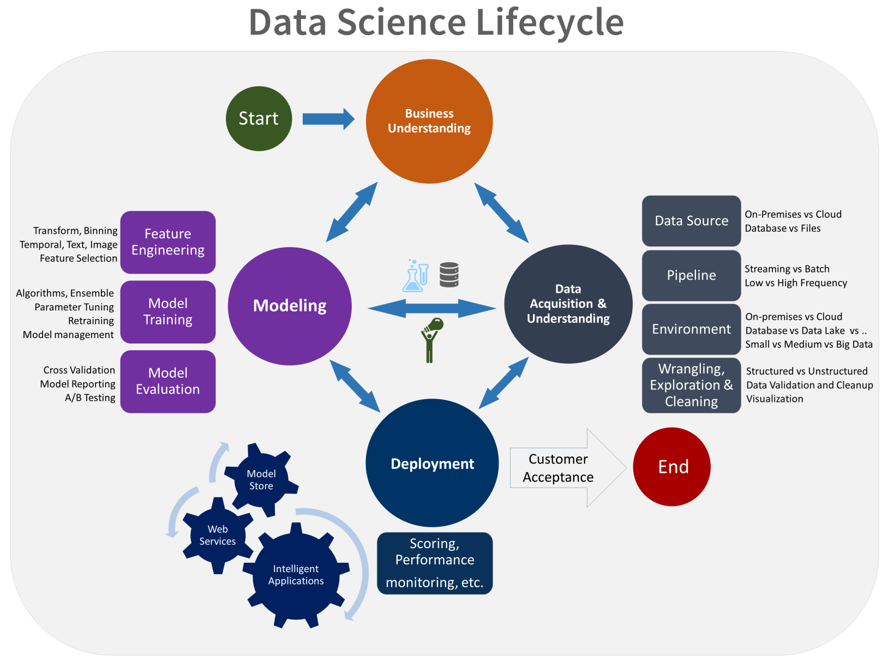
Team Data Science Lifecycle
https://docs.microsoft.com/en-us/azure/machine-learning/team-data-science-process/overview

Slide 4
The Data Handling Cycle – TES
What’s your question, how will you answer it?
Write an HYPOTHESIS
What do your results show, is it what you thought would happen?
1. Specifying and planning
evaluate
results
4. Interpreting and
discussing
2. Collecting data
Questionnaires filled in, results collected etc.
3. Processing and
representing
Show results in a table or graph, work out some averages
Notes:
https://www.tes.com/teaching-resource/the-data-handling-cycle-6191454

Slide 5
Data Handling Framework
Many big data analytics lifecycles or workflows can be found
The following steps are fairly typical of what is suggested:
Acquire data
Prepare or Process data
Analyse data
Report or visualise data
Act
All require some sort of question/business case to be answered
Important to track the provenance throughout the workflow
May have to justify decisions, so need to be able to reproduce the data processes undertaken.

Slide 6
Step 1: Acquiring the Data
This involves:
Identifying suitable data sets
Where is the data?
Can come from many places, local and remote
Can be many varieties: structured and unstructured
Can have different velocities
Acquire all the available data
If some left out may lead to incorrect conclusions
Querying the data
SQL and query browsers help examine the data

Slide 7








Step 1: Acquiring the Data
Data comes from many places
Every minute:
204 million emails are sent
200,000 photos are uploaded and
1.8 million likes are generated on Facebook.
On YouTube, 1.3 million videos are viewed and 72 hours of video are uploaded
And many ways to access it!
24th Aug 2015 saw 1 billion users login on a single day!
Notes:
Coursera quote – Big Data course
https://www.dailystar.co.uk/news/latest-news/461701/facebook-one-billion-logins
https://www.business-standard.com/article/news-ians/facebook-records-one-billion-logins-in-a-day-115082800461_1.html
https://www.telegraph.co.uk/technology/2017/05/03/facebook-approaches-2-billion-users/

Slide 8





















Step 1: Acquiring the Data
Text files and
Excel spreadsheets
Traditional databases
NoSQL
Storage
Data
Sources
Scripting
languages
Remote
data
REST
Web
Socket
Notes:
DBMS: MySQL, Oracle and PostgreSQL
Text file and spreadsheet: NotePad++ and Excel
Scripting languages: Ruby, JavaScript, Perl, Python and PHP
Remote data: RSS, XML, JSON, W3C and HTML5
Remote data
Web pages should be written using standards approved by the W3C
Includes many formats and services
eXtensible Markup Language (XML)
REST (REpresentational State Transfer)
Web Socket services – allow real time modifications from web sites

Slide 9
Step 1: Found Data Examples
Name | URL
ONS | https://www.ons.gov.uk
EU Stats | http://ec.europa.eu/eurostat
European commission stats | http://ec.europa.eu/eurostat/data/statistics-a-z/abc
UK Government | https://www.gov.uk/government/statistics
US Government | https://www.usa.gov/statistics
Edinburgh University data share | http://datashare.is.ed.ac.uk/
List of high quality data sets | https://github.com/caesar0301/awesome-public-datasets
AW public data sets | https://aws.amazon.com/datasets/
Comparative political data set | www.cpds-data.org
Stanford – Computational Journalism lab | http://cjlab.stanford.edu/
KDNuggets – data sets for mining/discovery | www.kdnuggets.com/datasets/
UK Healthcare | http://www.hscic.gov.uk/datasets
Halifax house prices | http://www.lloydsbankinggroup.com/media/economic-insight/halifax-house-price-index/
Nationwide house prices | http://www.nationwide.co.uk/about/house-price-index/headlines
Historical weather | http://www.wunderground.com/history
House prices in the three months to October 2018 were 1.5% higher than in the same three months a year earlier
National Parks produce 22% price premium
Notes:
Halifax House Price Index: 19/11/18
Nationwide (19/11/18):
National Parks produce 22% price premium
22% premium for a property situated within a National Park
5% premium for a property within 5km of a National Park

Slide 10
Step 1: Analysed Data Examples
Website | URL
Fact checking E.g., 16/11/18 NI and Brexit | https://fullfact.org/ https://fullfact.org/europe/brexit-agreement-northern-ireland/?utm_source=homepage&utm_medium=main_story
Mapping inequalities in England | https://theconversation.com/heres-what-we-learned-from-mapping-out-englands-inequalities-48562
How to know if where you live is “up and coming” | https://medium.com/@Sam_Floy/how-to-know-if-where-you-live-is-up-and-coming-fried-chicken-vs-coffee-shops-546080119f98
Find meaning in 40 years of UK political debate | https://thestack.com/iot/2015/10/14/big-data-40-years-uk-parliament-debate-complex-politics/
Evolution of US Girls Names over 100 years | https://youtu.be/qVh2Qw5KSFg
Evolution of US Boys names | https://www.youtube.com/watch?v=WQv99sEPDsw
Popular UK baby names | http://www.babycentre.co.uk/popular-baby-names
Nuclear Detonations from 1945 | https://cdn.theguardian.tv/mainwebsite/2015/08/14/150813Detonations_FromGAus-16x9.mp4
World’s best footballers (2015) | http://www.theguardian.com/football/datablog/2015/dec/24/worlds-best-footballers-and-where-they-play-the-numbers-crunched

Slide 11
Step 1: Measurement Scales
Once the data is acquired you need to know what sort of data types it contains, since this will affect what analysis you can do
For any statistical analysis it is important to know about the different scales of measurement:
INTERVAL Scale with a fixed and defined interval e.g. temperature or time.
ORDINAL Scale for ordering observations from low to high with any ties attributed to lack of measurement sensitivity, e.g. score from a questionnaire.
NOMINAL with order Scale for grouping into categories with order, e.g. mild, moderate or severe. This can be difficult to separate from ordinal.
NOMINAL without order Scale for grouping into unique categories, e.g. eye colour.
DICHOTOMOUS As for nominal but two categories only, e.g. male/female.
Also important is whether the data is:
CATEGORICAL (quantitative) Data that represent categories, such as dichotomous (two categories) and nominal (more than two categories) observations, are collectively called categorical.
NUMERICAL (qualitative) Data that are counted or measured using a numerically defined method are called numerical.
Notes:
https://statsdirect.com/help/content/basics/measurement_scales.htm

Slide 12
Step 2a: Prepare the Data
Once you have the data, you need to understand it before building a model with it.
Involves two sub-steps
Exploring the data
The Goal is to understand your data
What it means
Its quality and format
Carry out some preliminary analysis
Look at some samples of the data to try and understand it
Look for
Trends
Correlations
Outliers
Carry out some statistics

Slide 13
Step 2a: Prepare the Data
Statistics include:
Mean: average score of the data
Mode: values that occur most frequently in the data set
Median: middle value in a data set
Range: measures the difference between the largest and smallest values
Standard deviation: a measure used to quantify the amount of variation in a set of data values
Count: count number of values
Sum: sum total of values in a dataset
Min and Max: minimum and maximum values
These can help identify if there is something wrong in the data
For example, negative numbers or percentages greater than 100 for exam scores
Will be used later too for more complex analysis
Initial visualisations can help

Slide 14
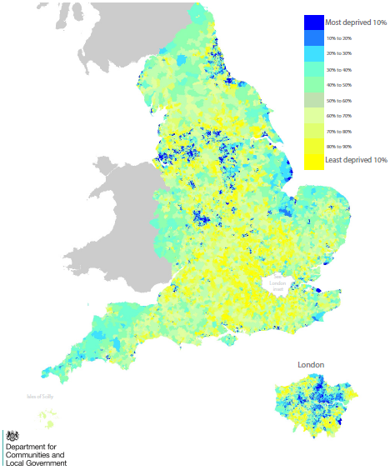
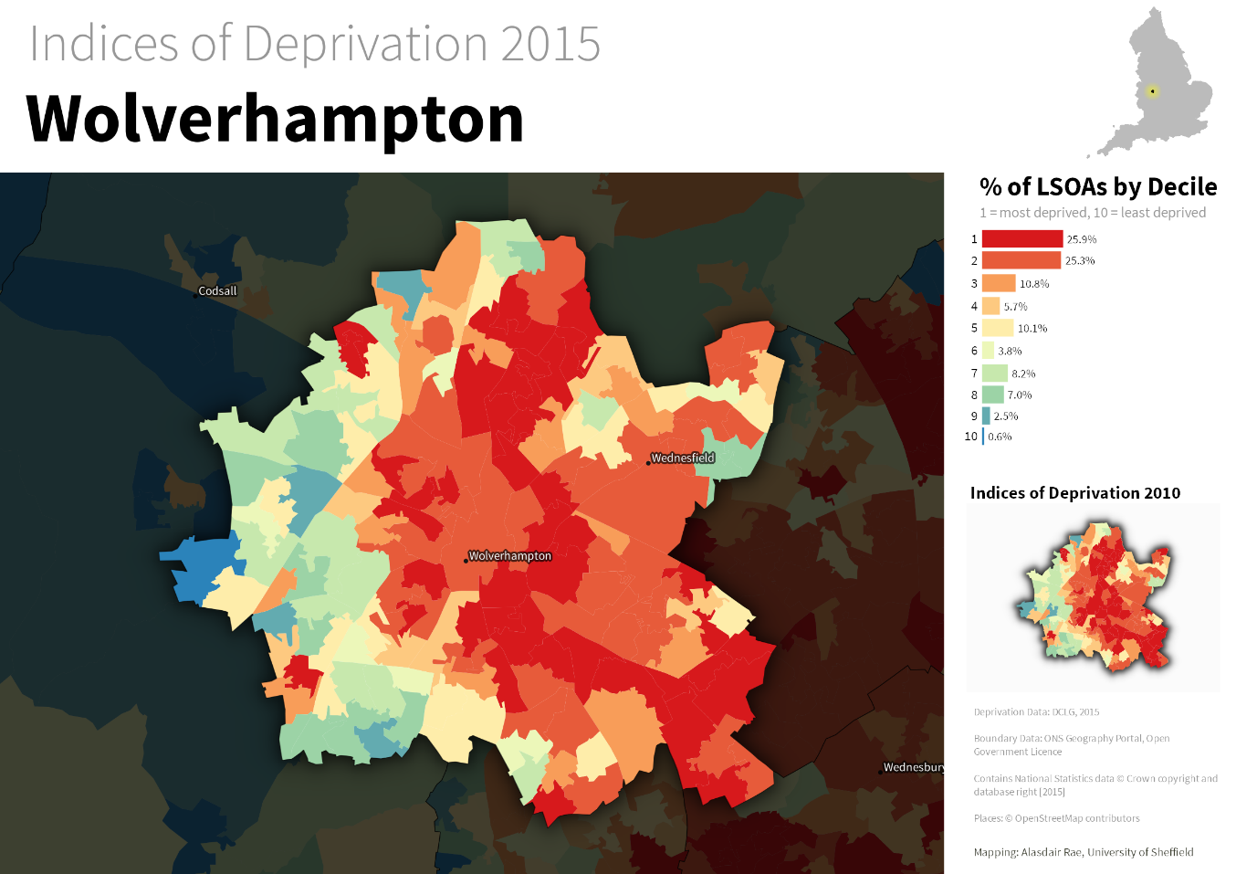
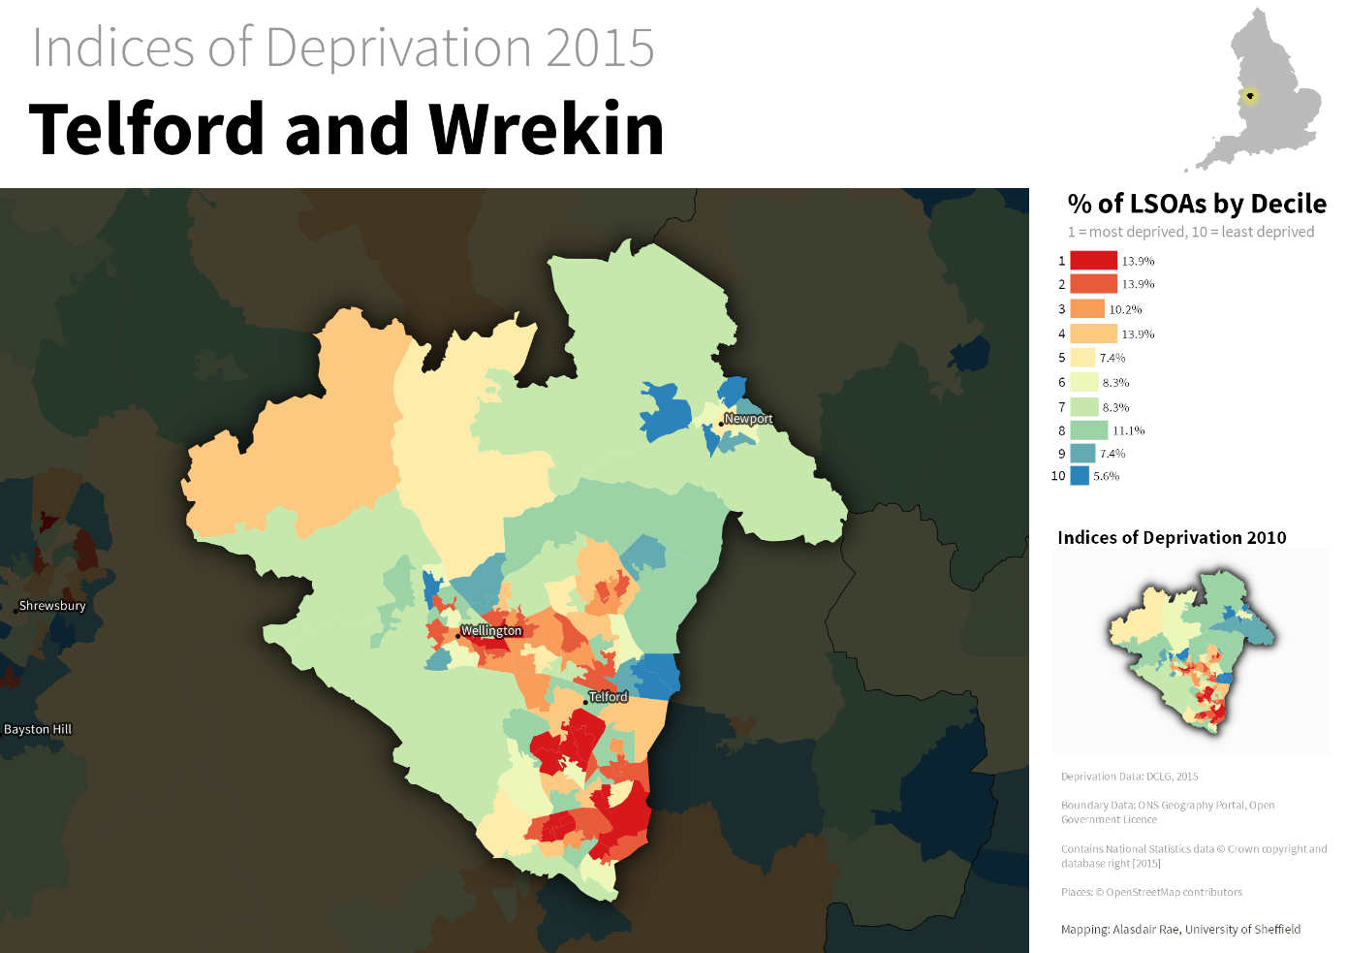
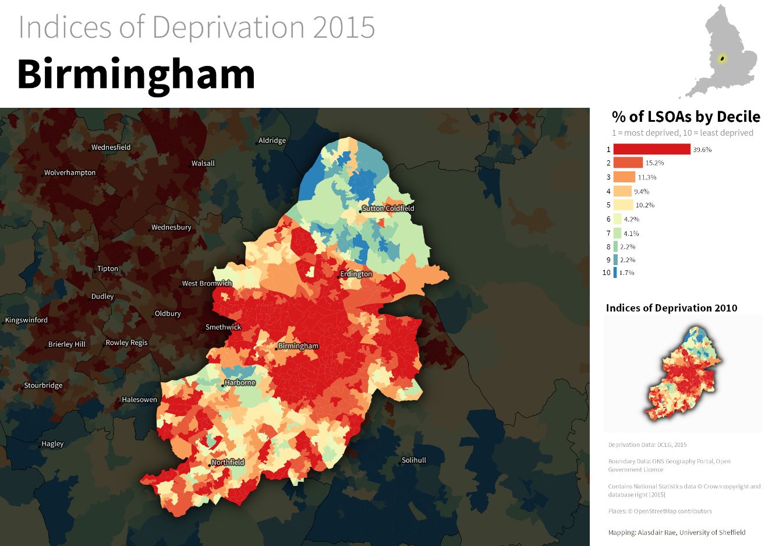
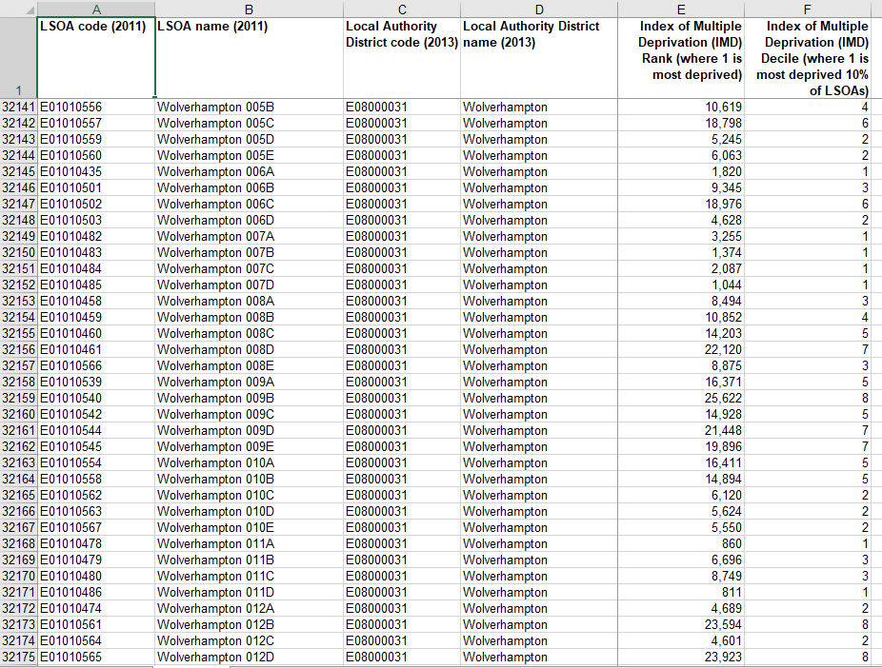
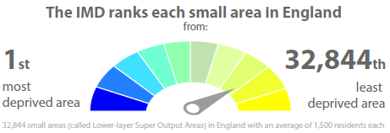
Step 2a: Visualisation Examples
Heat Maps/Infographics
Can quickly show where the hotspots are
E.g., English Index of Multiple Deprivation (IMD) 2015
More meaningful as an image?
Sample raw data
Notes:
Statistics data from: https://www.gov.uk/government/statistics/english-indices-of-deprivation-2015
Local images from: http://ajrae.staff.shef.ac.uk/imd15/

Slide 15
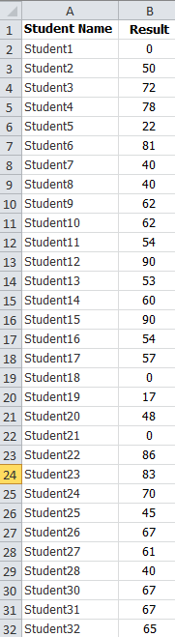
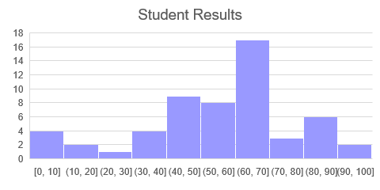
Step 2a: Visualisation Examples
Histogram
Can show the distribution of the data and any skewness or unusual dispersion
Given this set of student results, can you predict their overall performance?
Does this make it easier?

Slide 16
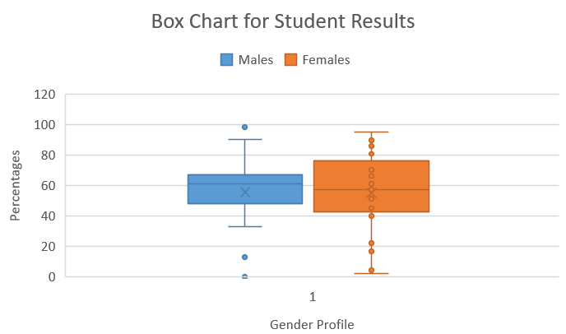
Step 2a: Visualisation Examples
Boxplots
Another type of plot for showing data distribution
Useful for identifying outliers and comparing distributions
Excel calls these Box and Whisker charts
“Whiskers” give additional information about the spread
“Whiskers” are vertical lines that end in a horizontal stroke
Individual scores represented by dots
X = Mean
Grey line = median
Outliers
Notes:
http://onlinestatbook.com/2/graphing_distributions/boxplots.html
https://www.dummies.com/education/math/statistics/box-and-whisker-charts-for-excel/

Slide 17
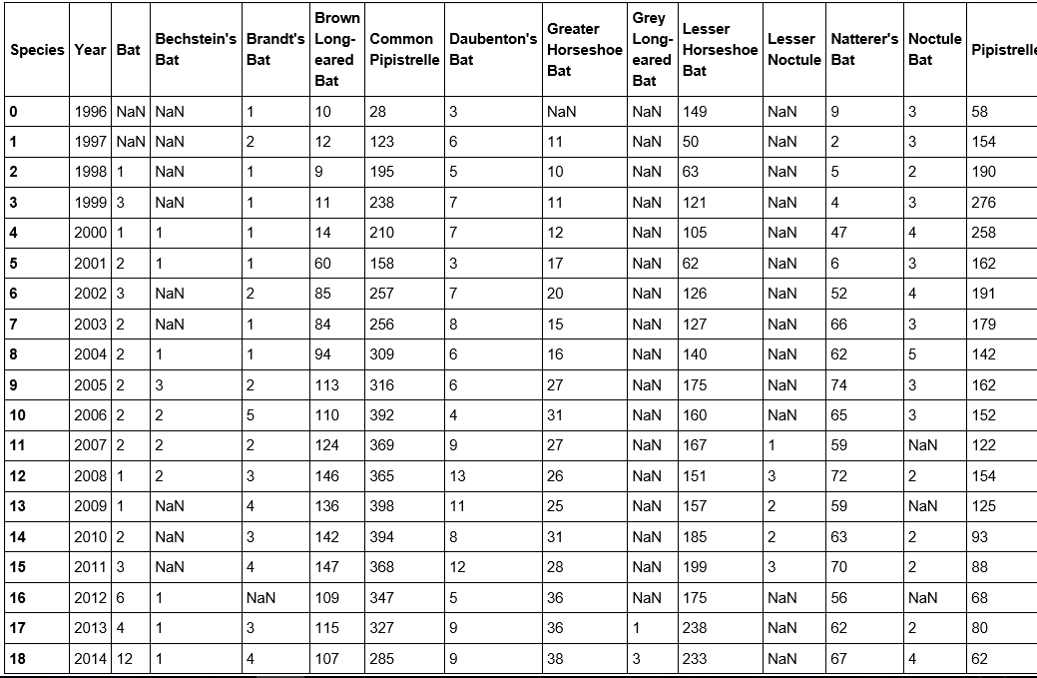
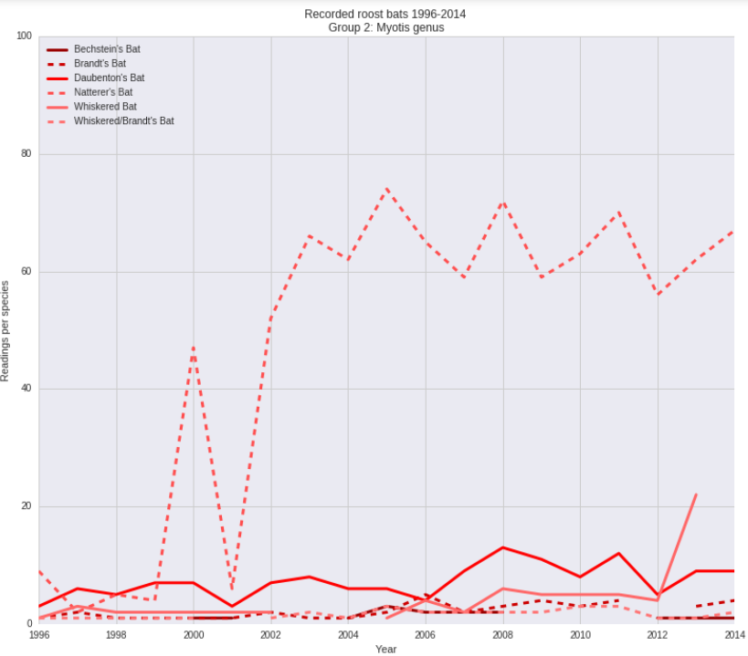
Step 2a: Visualisation Examples
Line graphs
Useful for seeing how values in the data changes over time.
Spikes in the data are also easy to spot
For example data on bats:
Easier to visualise using line chart:
Notes:
Bat Conservation Trust dataset from the National Biodiversity Network (NBN) http://www.nbn.org.uk/
Need to register to obtain data.

Slide 18
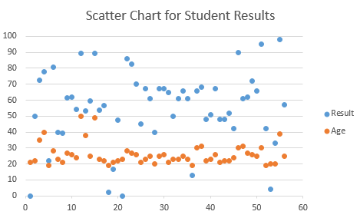
Step 2a: Visualisation Examples
Scatter plots
Can show correlation between two variables
Is there any correlation between results and a student‘s age?

Slide 19
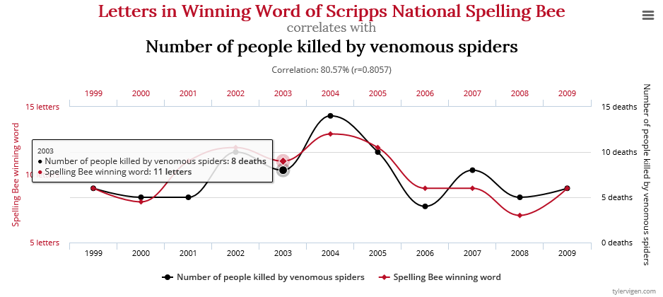
Correlation
Beware: correlation does not always imply causation!
http://tylervigen.com/spurious-correlations

Slide 20
Step 2b: Prepare Data
After the exploratory analysis you need to prepare the data
The raw data acquired is not usually in the format you want
Integration
You may need to merge data from multiple sources
Are they all using the same formats, naming conventions?
E.g., date formats can vary in DBMSs:
Oracle’s DD-MON-YY v’s MySQL YYYY-MM-DD
Two main goals in data pre-processing:
Clean the data to address data quality issues
Transform the raw data to make it suitable for analysis
Notes:
WS – give examples of messy data

Slide 21
Step 2b: Pre-process the Data
Clean the data
Garbage In Garbage Out
Real-world data is messy!
Inconsistent values
Customer with 2 different addresses
Duplicate records
Customer with more than one record
Missing values
E.g., missing a customer’s age which is needed for a demographic study
Invalid data
Postcode in the wrong format
Outliers
Values that are much higher/lower than expected

Slide 22
Step 2b: Prepare Data
You will have to decide and document whether to:
Remove data with missing values
Merge duplicate records
Need to decide what to do if they have conflicting values?
E.g., keep the latest value
Generate best estimates for invalid values
E.g., estimate a missing employee’s age from their length of service
Remove outliers
Could be real values that were just extremes on occasions

Slide 23
Step 2b: Cleaning Data
Common types of data errors (Kim 2003):
Dirty data error | Description
Validity | Do values match constraints? Are values in range?
Accuracy | Are values accurate, e.g., compare to reference lookup? Correct spelling? Correct capitalisation?
Completeness | Are all mandatory fields present, that is, not null?
Consistency | Are the same type values in different cells in the same column, e.g., names, numbers?
Uniformity | Are formats the same for the same fields, e.g. dates? Is white space present? Are Units of Measurement the same?
Handling dirty data:
Approach | Outcome
Fix it | Replace incorrect value with correct value Insert missing values
Remove it | Delete value or group of values => impact?
Replace it | Put marker in dataset indicating it is an inappropriate value
Leave it | Note and accept any dirty data
Don’t forget to document what has been added/deleted/changed
Notes:
Kim, W., Choi, B. J., Hong, E. K., Kim, S. K. and Lee, D. (2003) ‘A taxonomy of dirty data’, Data Mining and Knowledge Discovery, vol. 7, no. 1, pp. 81–99. In library.
Search for: “A taxonomy of dirty data” in the Library resources: https://librarysearch.wlv.ac.uk/

Slide 24
Step 2b: Cleaning Data
Below is a sample student data set for the fictitious Borchester University.
What issues are there with this data?
studentNo | studentName | Gender | DOB | avgMark
1234 | Johnny Rick Philips | b | 12-Jan-08 | 59
2345 | Sheila Hebden Lloyd | f | 22/04/1957 | 85
3355 | Perks, Jamie | m | 09/25/05
4455 | will grundy | m | 23-Feb-81 | 105
6541 | Madikane, Kate | F | 02/08/1978 | -55
Mixed case, inconsistent first and surname order
Inconsistent case, b = boy?
Inconsistent date formats
Percentages? Minus or >100 ok?

Slide 25
Step 2b: Prepare Data
Knowledge about the application the data came from is important
How the data was collected; intended use
Called the domain knowledge
The domain knowledge helps make informed decisions on how to handle incomplete or incorrect data
For example, if there were no integrity checks, there is more likely to be rogue data
Getting data into shape is called many things:
Data munging
Data wrangling
Data pre-processing
Data manipulation

Slide 26
Step 2b: Prepare Data – Operations
Types of operations include:
Dimensionality reduction
E.g., change 3D model to 2D
Data manipulation
Shaping the data to fit new requirements
Filtering the data – may not need everything
Transformation
To reduce noise and variability
One example is aggregation.
This generally results in data with less variability.
For example, daily sales figures may have many peaks and troughs. Aggregating values to weekly or monthly sales figures will result in similar data

Slide 27
Step 2b: Prepare Data – Operations
Feature selection
Remove redundant or unnecessary features
Two features may be correlated, so one could be removed, such as VAT paid
Combine features, such as adding salary and commission to create a total salary
Creating new features, such as adding an applicant’s education level to a loan approval
Scaling
Involves changing the range of values to be between a specified range
Done to avoid large values dominating the results

Slide 28
Step 3: Analyse the Data
Involves several steps
Select analytical techniques
Build models
This may need several iterations and involve going back to Steps 1 and 2
E.g., if need further data or need to package the data using a specific format
This involves taking the input data from the previous steps and generating an output model
Validate Model

Slide 29
Step 3: Analyse the Data
Categories of Analysis Techniques
Classification
Goal: predict category
E.g., predict weather as sunny, rainy or cloudy
Regression
Goal: predict numerical value
E.g., predict price of a stock
Clustering
Goal: organise similar items into groups
E.g., organise customers to seniors, adults and teenagers
Association Analysis
Goal: find rules to capture associations between items
E.g., if you buy one item, what else might you buy
Graph Analytics
Goal: Use graph structures to find connections between entities
E.g., explore spread of a disease by analysing hospital records

Slide 30
Step 3: Analyse the Data
Before moving on you need to evaluate the results
For example,
For classification and regression you could compare the predicted values against some correct values.
For clustering do the groups make sense for the application?
For association analysis and graph analysis, further investigation is needed to check whether the results are correct. E.g., does what your model predict actually happen?

Slide 31
Step 4: Communicate Results
Evaluation of the analytical results
Usually involves Visualisation techniques
A picture is worth a 1000 words!
Involves interpreting the results, summarising or visualising
May need to acknowledge the source of data if the licence agreement requires this.
Various tools exists to help with the visualisation:
Power BI
Tableau
Google Charts
R and Python
Many others…..

Slide 32
Step 5: Apply Results
There should be some purpose to the exercise
The main reason why data science is needed
Involves reporting insights from the analysis and determining actions
May involve helping business needs
Need to determine next steps:
Is extra analysis needed to yield better results?
Any data needs revisiting?
Any further opportunities to explore?
Remember: big data and data science are only useful if the insights can be turned into actions and the actions are carefully defined and evaluated.

Slide 33
Summary
This lecture has looked at a variety of techniques in the data science process:
Acquire data
Prepare or Process data
Analyse data
Report or visualise data
Act
Note: these steps should be an iterative process!

